Slide 1

Two-Day Dyadic data analysis Workshop
Randi L. Garcia
Smith College
UCSF January 9th and 10th
 @RandiLGarcia  RandiLGarcia

Slide 2
Day 2
Moderation in the APIM
Mediation in the APIM
Dyadic Growth Curve Modeling
Other Longitudinal Models for Dyads

Slide 3
Moderation

Slide 4
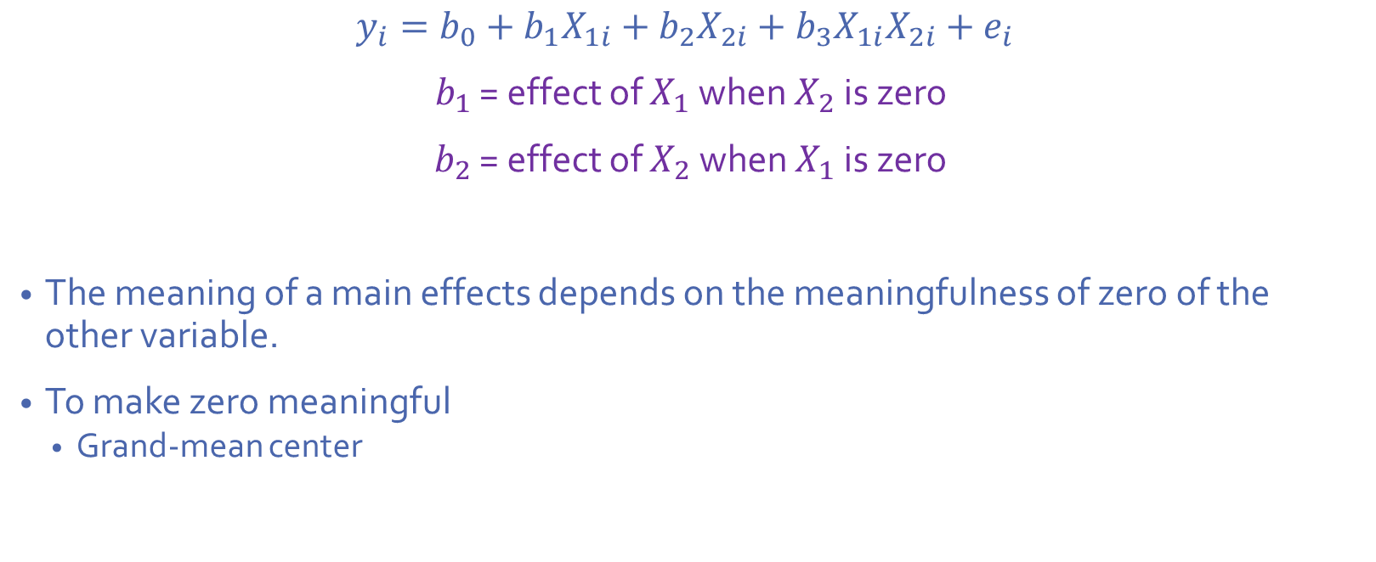
Centering Review
$$y_{i}=b_{0}+b_{1}X_{1i}+b_{2}X_{2i}+b_{3}X_{1i}X_{2i}+e_{i}$$
$b_{1}$ = effect of $X_{1}$ when $X_{2}$ is zero
$b_{2}$ = effect of $X_{2}$ when $X_{1}$ is zero
The meaning of a main effects depends on the meaningfulness of zero of the other variable.
To make zero meaningful
Grand-mean center

Slide 5
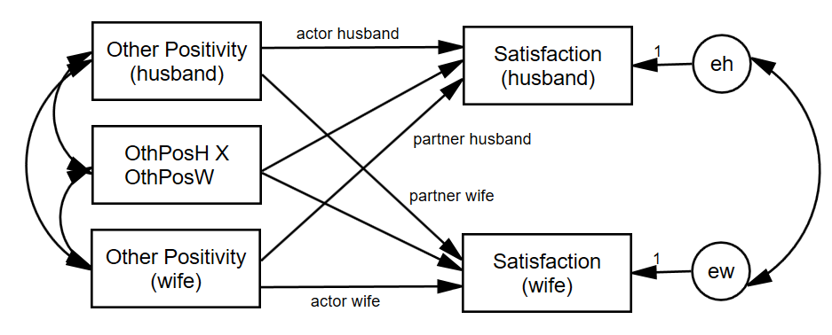
Actor-Partner Interactions
We can ask, does the actor effect get stronger or weaker as the partner variable goes up?

Slide 6
Dichotomous Within-Dyads Moderator
The distinguishing variable is a moderator.
The two partners each have a score but across dyads the scores are the same (e.g., gender in heterosexual couples)
If dyad members are distinguishable, two moderation effects
Moderates the actor effect
Moderates the partner effect

Slide 7
Between-Dyads Moderator
One moderation variable per dyad
Examples
Years married
Couple level treatment
Gay vs. lesbian couples
Twins: separated at birth vs. raised together

Slide 8
Number of Effects
One moderation variable
Indistinguishable: Two moderation effects
Moderates the actor effect
Moderates the partner effect
Distinguishable: Four moderation effects
Moderates the actor effect for each member
Moderates the partner effect for each member

Slide 9
Mixed Moderator
The two partners each have a score, and the average score varies across dyads
Indistinguishable: Four moderation effects
actor effect moderated by each member’s closeness
partner effect moderated by each member’s closeness
Distinguishable: Eight moderation effects
Each of the above also moderated by member type (e.g., husband and wife)

Slide 10
Simplifying Mixed Moderators
Actor-only moderator
Partner-only moderator
Sum (or average) of actor and partner moderator variables (couple moderator)
Difference between actor and partner moderator variables (contrast moderator)
k weighted

Slide 11
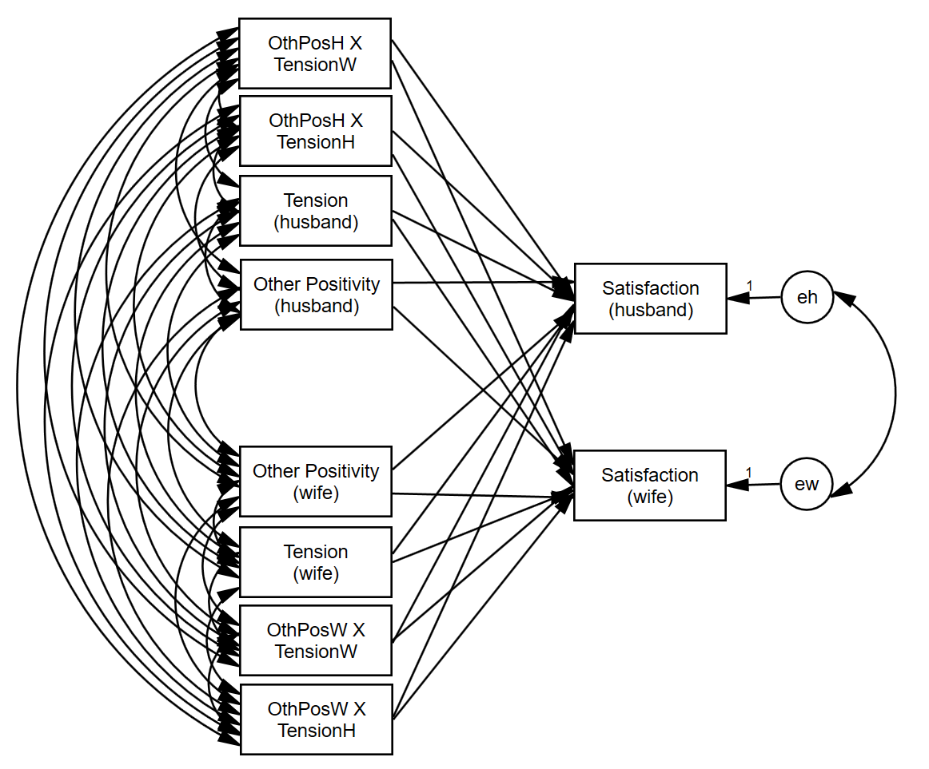
Example-Mixed Moderator, Distinguishable
Moderators: Actor perceived tension, partner perceived tension
Plus eight interaction terms effects

Slide 12
Example-Mixed Moderator, Indistinguishable
Moderators: Actor perceived tension, partner perceived tension
Plus 4 interaction terms effects
The figure is not helpful.

Slide 13
R Demo

Slide 14
Mediation

Slide 15
Mediation
c
X
Y

Slide 16
Mediation
M
a
b
c'
X
Y

Slide 17
The Four Paths
X → Y: path c
X → M: path a
M → Y (controlling for X): path b
X → Y (controlling for M): path c′

Slide 18
Decomposition of Effects
Total Effect = Direct Effect + Indirect Effect
c = c′ + ab
Note that
ab = c - c′
Percent of the total effect mediated:
ab/c *100
or
(1 - c′/c ) *100

Slide 19
Strategies to Test null hypothesis: ab = 0
Sobel test
Bootstrapping
Monte Carlo Method

Slide 20
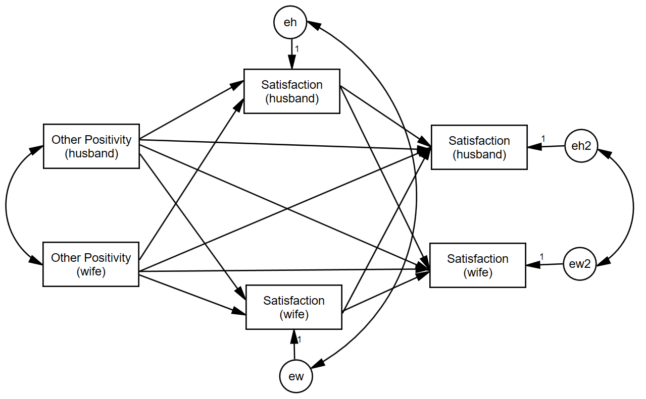
Example-Tension, Distinguishable

Slide 21
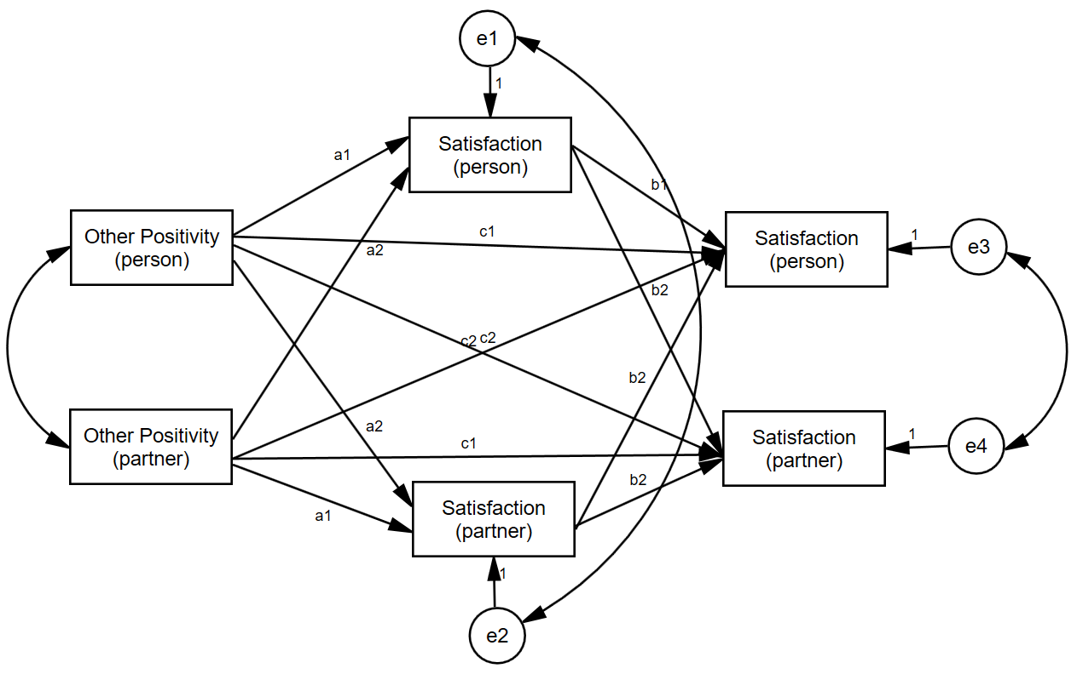
Example-Tension, Indistinguishable

Slide 22
R Demo

Slide 23
Longitudinal Models

Slide 24
Examples of Over-Time Dyadic Data
Daily diary reports of relationship experiences from both members of heterosexual dating partners over 14 days
Repeated measures experiment where dyads interact with each other multiple times and make ratings after each interaction
Daily reports of closeness from both members of college roommate dyads

Slide 25
Basic Data Structure
The three-level nested myth: Time is nested within person and person is nested within dyad
Three-level nested only if the four time points differ such that T1a ≠ T1b, T2a ≠ T2b, etc.

Slide 26
Basic Data Structure
In most cases the two dyad members are measured at the same time points, so Time is crossed (or cross-classified) with person.
Dyad 1
Husband
Wife
T1
H_T1
W_T1
T2
H_T2
W_T2
T3
H_T3
W_T3
T4
H_T4
W_T4

Slide 27
Basic Data Structure
This two-level crossed structure results in an error structure in which the residuals may be correlated both
across dyad members
across time
H - Time 1
H - Time 2
H - Time 3
H - Time 4
Satisfaction
Satisfaction
Satisfaction
Satisfaction
eM1
eM2
eM3
em4
eF1
eF2
eF3
eF4
W - Time 1
W - Time 2
W - Time 3
W - Time 4
Satisfaction
Satisfaction
Satisfaction
Satisfaction

Slide 28
Types of Over-Time Models
Repeated Measures Model
Interest only in the effects of “time” across persons and dyads.
Growth Curve Model
Are there linear changes over time in the outcome variable?
Stability and Influence Model
Stability: Does Person A’s score at time 1 predict Person A’s score at time 2?
Influence: Does Person A’s score at time 1 predict Person B’s score at time 2?
Standard APIM
Different variables as the predictors and at the outcome
Does Variable 1 predict Variable 2?

Slide 29
Examples
Repeated Measures
The effect of day of the week (weekday versus weekend) and gender
Growth Curve Model
Individual growth curve
Dyadic growth curve
Satisfaction over time
Stability and Influence Model
Prior satisfaction predicts current satisfaction
Standard APIM
Actor and partner conflict predict satisfaction
Notes:
EDIT

Slide 30
Types of Variables
Time Invariant
Do not change over time
Measured at one time point only (typically the beginning of the study)
E.g., gender, attachment style, race
Time Varying
Measured at each time
E.g., daily mood, twice-weekly reports of friendship
Outcome variable must be time varying

Slide 31
How Many Time Points?
Depends on type of analysis
The more complicated the model, the more time points needed
Minimum
Repeated measures: Two
Other models: Three
More is better.
Ultimately depends on the model, the research setting, and research questions.

Slide 32
Example: Daily reports of conflict, support, and relationship satisfaction
Kashy data set
103 heterosexual dating couples
Assessed once daily for 14 days
Completed daily reports of relationship satisfaction and amount of conflict that day
Satisfaction and Conflict are time-varying
Pretest data for attachment avoidance
Measured for both people
Time invariant
Notes:
Only going to talk about satisfaction and attachment avoidance data
-back to kashy data

Slide 33
Person Period Pairwise Dataset
Each Person by Time combination has its own record
Person has its own variable (e.g., Person = 1, 2)
Occasion has its own variable (e.g., Day = 1 to 14)
Required for Multilevel Modeling

Slide 34
Person-Period Pairwise Dataset
ID | DYADID | PERSON | DAY | ASATISF | PSATISF | Years
25 | 13 | 1 | 1 | 2 | 3 | 3
25 | 13 | 1 | 2 | 5 | 6 | 3
25 | 13 | 1 | 3 | 7 | 8 | 3
25 | 13 | 1 | 4 | 4 | 2 | 3
26 | 13 | 2 | 1 | 3 | 2 | 3
26 | 13 | 2 | 2 | 6 | 5 | 3
26 | 13 | 2 | 3 | 8 | 7 | 3
26 | 13 | 2 | 4 | 2 | 4 | 3
Notes:
Highlighted in red to show that the data file is also pairwise, we have actor and partner data in there.
If you are not interetsed .
Have the SPSS output open

Slide 35
Modeling Two Growth Curves
Y_{Wti} = c_{Wi} + b_{Wi}T_{ti} + e_{Wti}
Y_{Mti} = c_{Mi} + b_{Mi}T_{ti} + e_{Mti}
Intercepts
c_{Wi} = Predicted value of women’s satisfaction at study midpoint for dyad i
c_{Mi} = Predicted value of men’s satisfaction at study midpoint for dyad i
Slopes
b_{Wi} = Average change in women’s satisfaction over time for dyad i
b_{Mi} = Average change in men’s satisfaction over time for dyad I
Errors at each time point
Women = e_{Wti}
Men = e_{Mti}

Slide 36
Correlation of the Residuals
If the man reports more satisfaction for a particular day than would be expected given the overall effect of time, does the woman also report more satisfaction for that day?

Slide 37
Random Effects: Variances
There are six variances
two intercepts
Do men (and women) differ from each other in their “time zero” predicted score?
two slopes for time
Do the slopes for men (and women) differ?
two error (distance from the line) variances
Error variances (deviations from the slope) for men and women

Slide 38
Random Effects: Within Person Correlations
Man intercept-slope correlation
If a man is highly satisfied at the study midpoint, is his change in satisfaction steeper?
Woman intercept-slope correlation
If a woman is highly satisfied at the study midpoint, is her change in satisfaction steeper?
38
Notes:
38
Make these faint (they need to be in here but we aren’t going to talk about them)

Slide 39
Four Between-Person Correlations
Correlation of the intercepts between partners
Overall, do women who have higher levels of satisfaction at the study midpoint tend to have male partners who are also higher in satisfaction at the study midpoint?
That is: Is there a correspondence between level of satisfaction?
Correlation of the slopes
Do women whose satisfaction changes over time tend to have male partners whose satisfaction also changes over time?
That is: Is there a correspondence between linear change in satisfaction?
Two slope-intercept correlations
Do women with higher levels of satisfaction have male partners who increase or decrease?
Do men with higher levels of satisfaction have female partners who increase or decrease
Notes:
Do we want to keep all of this?
-lighten these up. Emphasize the first two (less the third)

Slide 40
Specification of interdependence
 | Man Intercept | Woman Intercept | Man Time Slope | Woman Time Slope
Man Intercept | Var(1)
Woman Intercept | Corr(2,1) | Var(2)
Man Slope | Corr(3,1) | Corr(3,2) | Var(3)
Woman Slope | Corr(4,1) | Corr(4,2) | Corr(4,3) | Var(4)
The RANDOM Statement specifies the variances and covariances between the intercepts and slopes
Because the statement is ordered
/RANDOM Man Woman Man*TIME Woman*TIME

Slide 41
Why Random Effects Are Important
If the wrong random model is selected (one that is too complicated), the solution may not converge.
If the wrong model is selected (one that is too simple), significance tests of fixed are wrong.
Standard errors are biased
They are interesting in their own right.
Answers interesting questions about individual differences and similarity of dyad members.
Points to possible moderators.
Can be combined with fixed effects for interpretation.

Slide 42
R Demo

Slide 43
Longitudinal APIM

Slide 44
Longitudinal APIM
Man’s Actor
Man’s Conflict
Man’s Satisfaction
W to M Partner
M to W Partner
Woman’s Conflict
Woman’s Satisfaction
Woman’s Actor

Slide 45
Data Structure
ID | Dyad | Partnum | Time | Actor Satis. | Actor Conflict | Partner Conflict
25 | 13 | 1 | 1 | 2 | 5 | 5
25 | 13 | 1 | 2 | 5 | 2 | 3
25 | 13 | 1 | 3 | 7 | 5 | 6
25 | 13 | 1 | 4 | 4 | 7 | 8
26 | 13 | 2 | 1 | 3 | 5 | 5
26 | 13 | 2 | 2 | 6 | 3 | 2
26 | 13 | 2 | 3 | 8 | 6 | 5
26 | 13 | 2 | 4 | 2 | 8 | 7

Slide 46
Variances (in diagonal) and Correlations (off diagonal)
 | 1. | 2. | 3. | 4. | 5. | 6.
1. Man Intercept | 0.432**
2. Woman Intercept | 0.782** | 0.253**
3. Man's Actor | 0..410* | 0.254 | 0.023**
4. Woman's Actor | 0.363* | 0.546** | 0.166 | 0.024**
5. Man’s Partner (influenced by woman) | -0.015 | 0.046 | -0.092 | 0.407* | 0.022**
6. Woman’s Partner (influenced by man) | 0.422* | 0.502* | 0.548* | 0.733* | 0.152 | 0.008
* p < .05 ** p < .01

Slide 47
R Demo

Slide 48
Stability and Influence
Notes:
AKA responsiveness (as to make it not so partner focused)

Slide 49
Stability-Influence: APIM
Man’s Satisfaction Yesterday
Man stability
Man’s Satisfaction Today
Woman influence
Man influence
Woman’s Satisfaction Yesterday
Woman’s Satisfaction Today
Woman stability
We can measure stability and influence for each man and each woman:
Is stability moderated by gender?
Is influence moderated by gender?

Slide 50
Data Structure
ID | DYADID | PERSON | DAY | ASATISF | ASATISF Lagged | PSATISF Lagged
25 | 13 | 1 | 1 | 2 | . | .
25 | 13 | 1 | 2 | 5 | 2 | 3
25 | 13 | 1 | 3 | 7 | 5 | 6
25 | 13 | 1 | 4 | 4 | 7 | 8
26 | 13 | 2 | 1 | 3 | . | .
26 | 13 | 2 | 2 | 6 | 3 | 2
26 | 13 | 2 | 3 | 8 | 6 | 5
26 | 13 | 2 | 4 | 2 | 8 | 7

Slide 51
Random Effects
Variances in the diagonal and correlations off diagonal
 | 1. | 2. | 3. | 4. | 5. | 6.
1. Man Intercept | 0.138**
2. Woman Intercept | .650** | 0.094**
3. Man's Stability | -0.195 | 0.048 | 0.052**
4. Woman's Stability | -0.126 | -0.705* | -0.245 | 0.037*
5. Man Influenced by Woman | -0.126 | -0.515 | -0.216 | 0.774 | 0.350*
6. Woman Influenced by Man | 0.159 | 0.245 | 0.674* | 0.370 | 0.059 | 0.078**
* p < .05 ** p < .01

Slide 52
R Demo

Slide 53
(Current/Known) Limits of R
Indistinguishable dyads
Needs to be analyzed in SAS, HLM, or MLwiN because constraints on the variance-covariance matrix or random effects are needed.
Poor estimation algorithm
Incorrect p values for variances

Slide 54
Topics Not Covered
Indistinguishable dyads
Time-varying moderators
E.g., daily mood moderates daily satisfaction
Non-linear growth curve models
Transformations
Periodic effects
Cubic, quadratic
More complicated error models

Slide 55
Common Fate Model

Slide 56
Dyadic Models
The Common Fate Model (CFM) is perhaps the oldest dyadic model (Kenny & La Voie, 1985).
However, CFM used empirically only a handful of times.
However, the APIM which is regularly used (at least 95% of the time) may often be theoretically inappropriate.
Paper: Ledermann, T., & Kenny, D. A. (2012). The common fate model for dyadic data: Variations of a theoretically important but underutilized model. Journal of Family Psychology, 26, 140‑148.
Notes:
56

Slide 57
The CFM as a SEM Model
The Common Fate Model (CFM) consists of 2 latent variables (X and Y) and 2 indicators (XA and XB, YA and YB) where A and B are distinguishable members of a dyad.
e₁
e₂
e₃
e₄
1
1
1
1
X_{A}
X_{B}
Y_{A}
Y_{B}
a
a
1
1
1
1
X
a
Y
1
r_{Y}
The model has 1 df.
That 1 df can be viewed as testing if the loading on
X_{B} and Y_{B} are not equal to one. If fit is poor, the two loadings can be fixed to the same value.

Slide 58
Indistinguishable Members
Five equality constraints are made: equal X and Y intercepts, equal X and Y error variances, and equal error covariances.
e₁
e₂
e₃
e₄
1
1
1
1
X_{A}
X_{B}
Y_{A}
Y_{B}
1
1
1
1
X
a
Y
1
r_{Y}
With this constraints, the model has zero df.
Notes:
58

Slide 59
When Does the CFM Make Sense?
The latent variable represents a dyadic construct (“us,” “we,” or “the relationship” instead of “you” or “him or her”) or shared external influences.
The causal relation between the variables is presumed to be at the level of the dyad.

Slide 60
When Does the CFM Not Make Sense?
The variable measures an individual characteristic: how the individual feels or the individual’s personality.
The two dyad members scores correlate weakly with each other. If the correlation between the two X or Y scores is weak (r < .30), there can be estimation difficulties.

Slide 61
Relation to the APIM
Assume that CFM is the correct model.
For a CFM without correlated errors, the APIM is couple model: actor and partner effects are equal.
Note a couple level model will not necessarily be a good CFM unless the loadings are large.
As correlated errors increase, partner effects become absolutely smaller relative to actor effects.
Sometimes a CFM model can be ruled out if loadings are too small, but often there is no statistical reason to prefer a CFM over an APIM.
Notes:
61

Slide 62
Advantages of the CFM over the APIM
Has a true “dyad-level” effect, not individual-level effects
Parsimony: For moderation and mediation in the APIM, there can be up to 8 effects. For the CFM, there is just one. Thus, the CFM is simpler.
Notes:
62

Slide 63
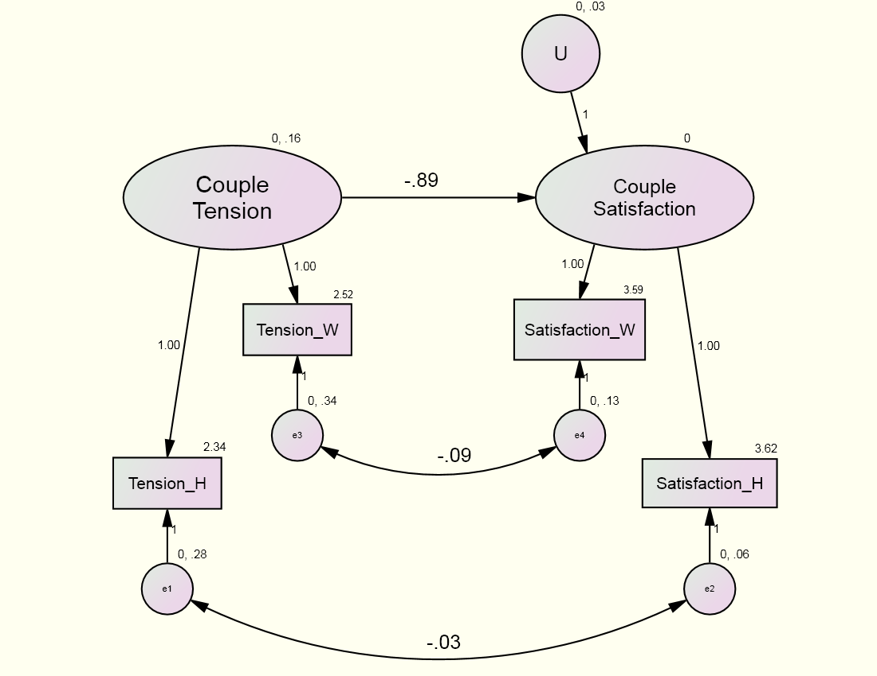
Example: Standard CFM
χ²(1) = 0.179, p = .672

Slide 64
R DEMO

Slide 65
Common fate growth model

Slide 66
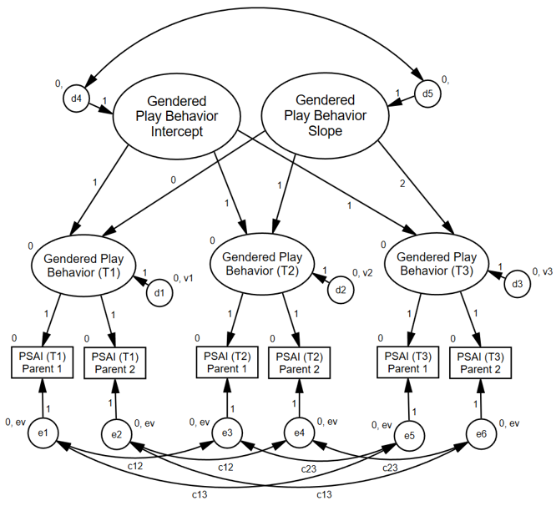
Children’s Gendered Behavior Overtime
Goldberg & Garcia (2016)

Slide 67
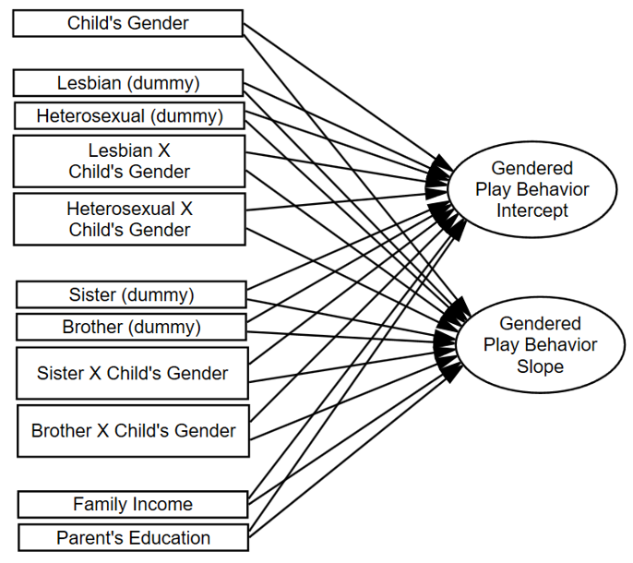
Children’s Gendered Behavior Overtime

Slide 68
Other SEM dyad models

Slide 69
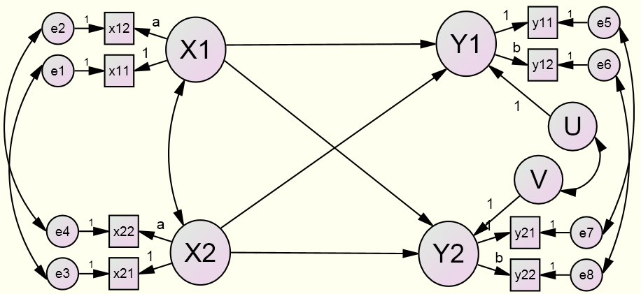
Latent Variable APIM
Advantages over Traditional APIM
Effects may be larger.
Effects are less biased.

Slide 70
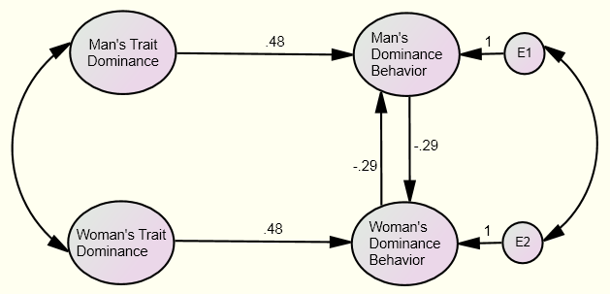
The Mutual Influence Model

